Slide 1


ARC Training Centre for Behavioural
Insights for Technology Adoption
AGENTIC SYSTEMS
A SHORT INTRODUCTION

Slide 2
Content
PART 1: Foundations of Agentic Systems
What Is an Agent?
Definitions: workflows vs agents
When to use agentic systems
Agents use case
LLM vs Agent: What Is the Difference?
Components of an Agentic System
LLM
Tools
Workflow / Orchestration

Slide 3
Content
Tools and Tool Calling
What is a tool?
Types of tools
API libraries
Search engines and search services
Retrieval-Augmented Generation (RAG)
Chunking (with and without overlap)
Embeddings and semantic similarity
RAG limitations
Rerankers: Bi-Encoders vs Cross-Encoders
RAG architectures (embedding only, with reranking, with knowledge graph)
Large Language Models
Model selection criteria
Closed vs open-weight models
Open-weight model types: instruct, reasoning, multimodal, MoE, code-specialised, small models
Model size and quantization
Local model tools: Hugging Face, Ollama, LM Studio, vLLM, llama.cpp
JSON for tool calling, schemas, memory and state

Slide 4
Content
Dynamic tool calling
Workflow / Orchestration
What orchestration controls
Workflow patterns: prompt chaining, routing, parallelisation, evaluator-optimiser, orchestrator-workers
PART 2: Agentic System in Practice
Example: Multi-Agent Academic Citation System
Open-source agents
References

Slide 5
WHAT IS AN AGENT: DEFINITIONS
Some define agents as fully autonomous systems that operate independently over extended periods, using various tools to accomplish complex tasks.
Others use the term to describe more prescriptive implementations that follow predefined workflows.
Anthropic categorizes all these variations as agentic systems, but draw an important architectural distinction between workflows and agents:
Workflows are systems where LLMs and tools are orchestrated through predefined code paths.
Agents, on the other hand, are systems where LLMs dynamically direct their own processes and tool usage, maintaining control over how they accomplish tasks.

Slide 6
WHAT IS AN AGENT: WHEN TO USE AGENTS
For achieving the objective, it is better to look for simple solutions first and add complexity if the initial solution is not good enough.
This means agentic systems may not be needed at all.
If agentic systems are needed
Agentic workflows
Offer more predictable behaviour
Are easier to debug and maintain
They are good for well-defined tasks
Agents:
Better for flexible tasks
On-the-go decision making is required
System behaviour and edge cases are harder to predict
Requires better safeguards

Slide 7
AGENTS USE CASES
Carefully designed agents can help us automate time consuming and low productivity tasks, however:
We need to acknowledge failures of such systems (possibility of hallucination for example)
Make sure the tasks is suitable for a system with such possible failures
Building an agent that does online shopping may not be a great idea
Systematic literature review and synthesis
Queries arXiv, PubMed, or Semantic Scholar across hundreds of papers autonomously
Extracts methodology, findings, and limitations from each paper as structured JSON
Deduplicates and clusters results by theme, producing a ranked synthesis with full source traceability
Compresses weeks of manual reading and note-taking into hours, with every claim linked back to its origin document

Slide 8
AGENTS USE CASES
Continuous data monitoring and anomaly reporting
Polls APIs and databases on a schedule, running statistical checks against expected baselines
Flags metrics that drift outside defined bounds, attaches the relevant data slice, and drafts a plain-language summary
Eliminates the need for a human to monitor dashboards overnight or over weekends
Delivers structured alerts with enough context that the on-call engineer can act immediately without digging
Document processing pipelines
Ingests contracts, invoices, or research reports and extracts named entities, dates, and key fields automatically
Classifies each document by type and populates a structured database without manual data entry
Flags records below a confidence threshold and routes only those to a human reviewer
Scales to thousands of documents without degradation: the human only ever sees the edge cases

Slide 9
AGENTS USE CASES
Structured critique
Checks every factual claim in a paper or proposal against its cited source, flagging unsupported assertions
Identifies logical gaps between sections
Where a conclusion is not actually supported by the preceding methodology
Tests internal consistency: do the numbers in the results section match the numbers in the tables?
Returns a ranked list of weaknesses by severity, giving the author a prioritised revision agenda before submission

Slide 10
AGENTS USE CASES
Other use cases:
"Make me a presentation”
"Handle my emails"
“Do regression”
"Clean data”
"Automate my weekly report”
"Do this boring thing I do every day"
The agent learns the pattern, turns it into a reusable skill, and runs it on autopilot

Slide 11
LLM vs AGENT WHAT IS THE DIFFERENCE?
LLM is only one component of an agentic system
It only receives text and generates text
Cannot “perform” tasks on its own
Doesn’t have access to reliable up-to-date information
Agent can “perform” tasks
It is not just a simple LLM call, there are steps and procedures the system follows for generating responses and performing tasks
It is what you see in ChatGPT and Claude (website not API)

Slide 12
LLM vs AGENT WHAT IS THE DIFFERENCE?
A simple example
"How is the weather in Brisbane today?"
LLM:
Looks at what it has learned
Might say:
“Brisbane typically has a humid subtropical climate. In March, it's usually warm with temperatures around 25°C. However, I don't have access to live data, so please check a local forecast.”
Or might hallucinate and say:
“It is windy today.”
Agent:
“The user is asking about weather, I need to check BOM before responding”
Looks it up
Might say:
“It is sunny today”

Slide 13
LLM vs AGENT WHAT IS THE DIFFERENCE?
“What does john et al. (2023) say about the role of expansionary monetary policy on CPI?”
A simple LLM call:
Understands the request
Thinks
Responds
An agent :
Understands the request
Builds search queries
Searches databases and gets the result
Reads them and then responds accordingly
The difference between a raw LLM and an agent is like the difference between an engine and a car

Slide 14
AGENTIC SYSTEM COMPONENTS
Agentic systems can be broken down into three major components
LLM
Tools
Workflow / Orchestration
LLM
The thinking component of the system
Decides
Responds
Executes tasks
Tools
“Limbs” of the LLM
They can be python functions and online services or other systems the LLM uses to perform tasks

Slide 15
AGENTIC SYSTEM COMPONENTS
Agentic systems can be broken down into three major components
LLM
Tools
Workflow / Orchestration
Workflow / Orchestration
When to call tools
When to retry
How to handle system failures, edge cases
When to stop
Whether to route to another agent / System / Subsystem
Whether human approval is needed

Slide 16
TOOLS AND TOOL CALLING

Slide 17
TOOLS AND TOOL CALLING
You pass a pdf to an agent
“Read the attached paper and summarize it for me.”
access the uploaded paper or PDF
extract the text
identify the important sections
distinguish abstract, methods, results, and conclusion
summarize the content clearly for the user
If the paper is long, the system may also need chunking, retrieval, or multi-step reading.
This makes it an agentic document-processing task, not just a text prompt.

Slide 18
TOOLS AND TOOL CALLING
A tool is a callable function or external capability that an agent can use to interact with the outside world.
It extends the model beyond text generation
It can read, fetch, calculate, search, parse, or act
The model can choose when to use it
The runtime executes it and returns the result

Slide 19
TOOLS AND TOOL CALLING
Tools:
Search tools: web/news search, academic search
File tools: read PDFs, inspect spreadsheets, parse documents
Data tools: query databases, filter tables, run calculations
Action tools: send email, schedule events, post content
Retrieval tools: vector search, RAG, internal document lookup
System tools: browser/computer use, API connectors

Slide 20
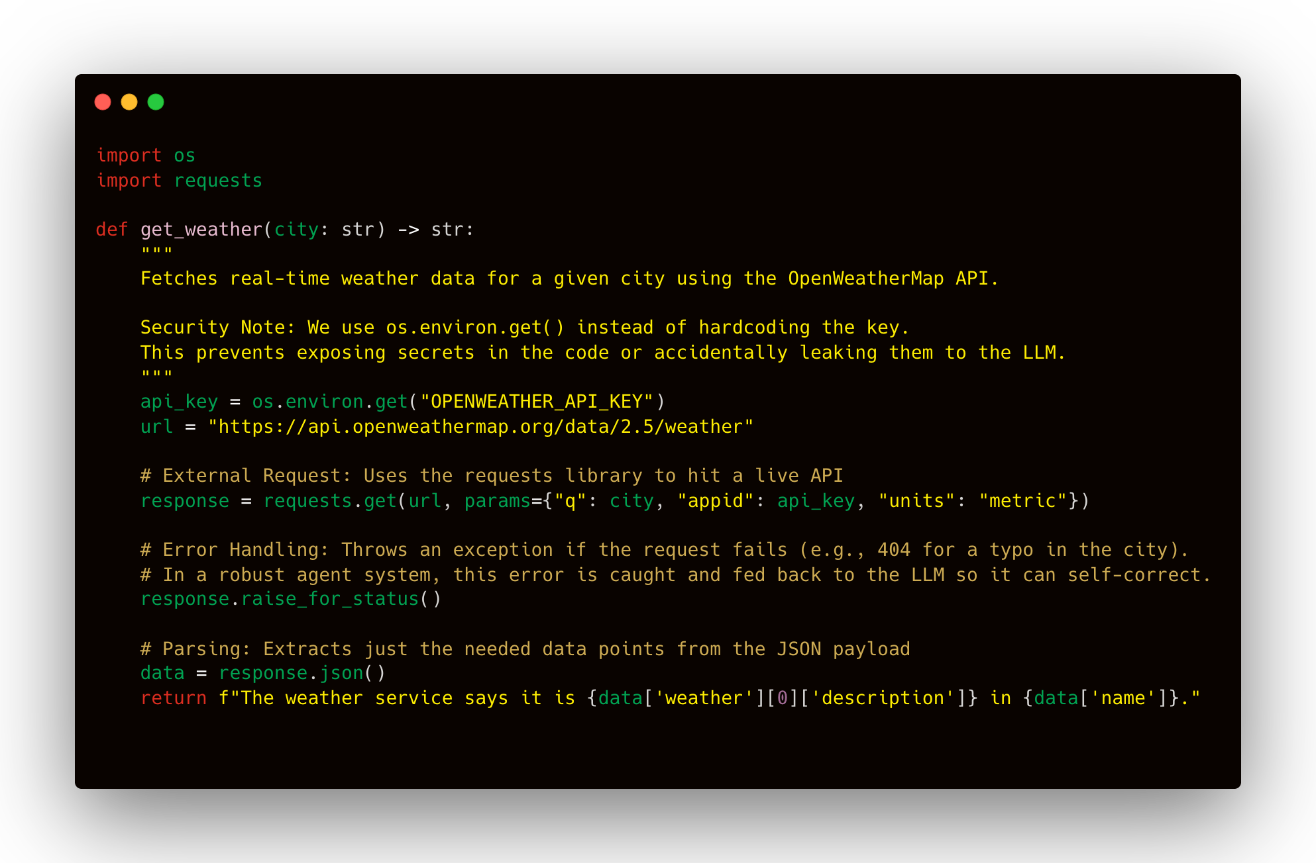
TOOLS AND TOOL CALLING: EXAMPLES

Slide 21
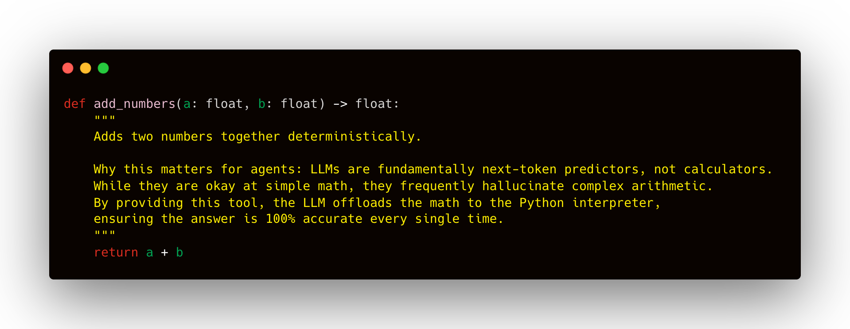
TOOLS AND TOOL CALLING: EXAMPLES

Slide 22
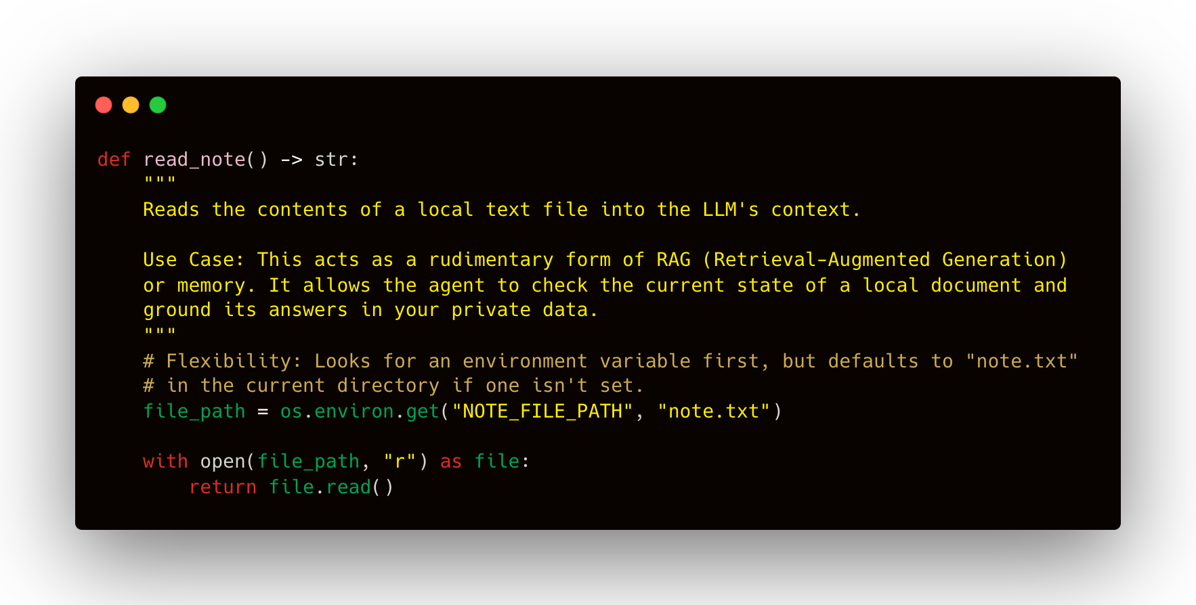
TOOLS AND TOOL CALLING: EXAMPLES

Slide 23
TOOLS AND TOOL CALLING: TECH STACK
Some common tools:
Request/API library
Search tools
RAG and vector retrieval
Tokenizers
Sentence transformers:
Embedding
Retrieval
Reranking
Vision tools
Grobid
Doclib
OCR
Much more

Slide 24
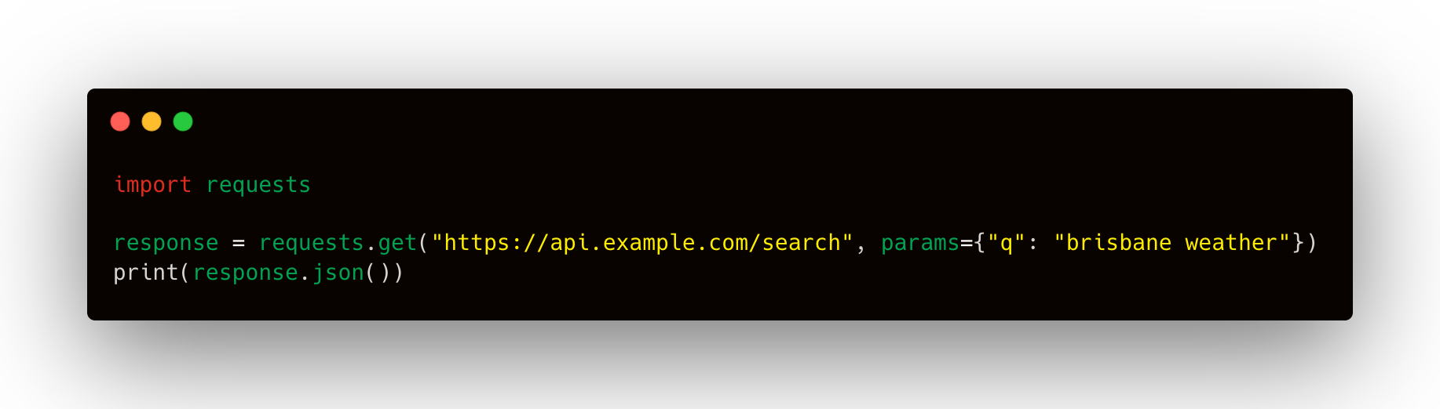
TOOLS AND TOOL CALLING: API LIBRARY
Let’s your code communicate with models and external services. In Python, this often starts with simple HTTP libraries such as requests, or SDKs provided by model vendors and service providers. In the OpenAI stack, the Responses API is the unified interface for building agent-like applications, including tool use, multi-turn interactions, and built-in tools.
SDK: software development kit

Slide 25
TOOLS AND TOOL CALLING: Search Engines and Search Services
Search tools give agents access to current information
DuckDuckGo: lightweight search, manual querying, privacy-oriented use
Tavily: agent-oriented web search and extraction
SerpApi: structured SERP access from major engines
Google, Anthropic and OpenAI built-in search tools
Many other services

Slide 26
TOOLS AND TOOL CALLING: Retrieval-Augmented Generation
The issue
We are dealing with a large amount of data (Databases /pdfs and documents)
LLMs have limited context window (128,000/ 256,000 / 1,000,000)*
The information might exceed LLMs context window
We cannot just pass all the content to the LLM
We need a better approach
That’s where retrieval systems come in
Retrieval-Augmented Generation is a system that retrieves the possibly relevant content from a huge corpora of data and sends them to LLM.
*LLM uses tokens to build text, for example: “token” = “to” + “ken”

Slide 27
TOOLS AND TOOL CALLING: Retrieval-Augmented Generation
RAG as a tool has multiple subsystems:
Data source: pdfs, word documents , websites, spreadsheets
Ingestion system: imports and prepares the raw data.
Chunking subsystem: splits documents into smaller pieces called chunks so retrieval can return relevant fragments rather than entire long files. Chunking decides the size of the knowledge units the system can retrieve.
Embedding subsystem: converts chunks of text into numeric vectors so the system can search by meaning, not just exact keywords.
Index / vector store subsystem: save for retrieval
Search and retrieve

Slide 28
TOOLS AND TOOL CALLING: Retrieval-Augmented Generation
Data source:
PDFs
Word documents
Website content
spreadsheets
Builds the knowledge base the model will rely on instead of answering only from training.

Slide 29
TOOLS AND TOOL CALLING: Retrieval-Augmented Generation
Ingestion subsystem
Takes files or external content and converts them into machine-usable text and metadata.
Chunking subsystem
It splits documents into smaller pieces called chunks so retrieval can return relevant fragments rather than entire long files.
Chunking with and without overlap
Chunking with overlap reduces the chance of retrieving incoherent content (chopped from the middle)
Example:
“Brisbane experienced heavy rainfall in March. Local authorities warned residents about flash flooding. Emergency services advised people to avoid low-lying roads. Several suburbs reported temporary transport disruptions. The weather system moved south by the evening.”

Slide 30
TOOLS AND TOOL CALLING: Retrieval-Augmented Generation
Without overlap:
Chunk 1 “Brisbane experienced heavy rainfall in March. Local”
Chunk 2 “authorities warned residents about flash flooding. Emergency services advised people to avoid low-lying roads. Several suburbs”
Chunk 3 “reported temporary transport disruptions. The weather system moved south by the evening. This is simple, but it can break context if an important idea sits across chunk boundaries.”

Slide 31
TOOLS AND TOOL CALLING: Retrieval-Augmented Generation
With overlap:
Chunk 1 Brisbane experienced heavy rainfall in March. Local authorities warned residents about flash flooding.
Chunk 2 Local authorities warned residents about flash flooding. Emergency services advised people to avoid low-lying roads.
Chunk 3 Emergency services advised people to avoid low-lying roads. Several suburbs reported temporary transport disruptions.
Chunk 4 Several suburbs reported temporary transport disruptions. The weather system moved south by the evening.

Slide 32

TOOLS AND TOOL CALLING: Retrieval-Augmented Generation
Embedding
An embedding is a numerical representation of data.
It means turning text into a list of numbers (vectors) that captures some of its meaning.
Instead of storing a sentence only as words, the system also stores it as a vector.
For example: “cat” might have a semantic representation such as: [0.12, −0.44, 0.91, 0.03]
Embeddings are usually much longer than this. They might have hundreds or thousands of dimensions
Take these two sentences:
“The cat is sleeping on the sofa.”
“A kitten is resting on the couch.”
An embedding system tries to convert both into vectors that are numerically close.
$Sentence 1→\left[0.2, 0.8, −0.1\right]$
$$Sentence 2→[0.25,0.75,−0.05]$$

Slide 33

TOOLS AND TOOL CALLING: Retrieval-Augmented Generation
What is semantic similarity
Once text is turned into vectors, the system compares vectors mathematically
The most common measure is cosine similarity
Cosine similarity
measures the angle between two vectors.
If two vectors point in almost the same direction, cosine similarity is high.
If they point in different directions, cosine similarity is low.
$\cos\left(θ\right)=\frac{A.B}{\left\|\left.A\right\|\right.\left\|\left.B\right\|\right.}$
A⋅B is the dot product
∥A∥ is the length of vector A
∥B∥ is the length of vector B

Slide 34

TOOLS AND TOOL CALLING: Retrieval-Augmented Generation
Let:
𝐴=[1, 2]
𝐵=[2, 4]
Step 1: dot product
𝐴⋅𝐵=(1)(2)+(2)(4)=2+8=10
Step 2: length of A
∥𝐴∥=$\sqrt{1^{2}+2^{2}}=\sqrt{5}$
Step 3: length of B
$\text{∥}\text{B}\text{∥}=\sqrt{2^{2}+4^{2}}=\sqrt{20}$
Step 4: cosine similarity
$\cos\left(θ\right)=\frac{10}{\sqrt{5}\sqrt{20}}=\frac{10}{10}=1$
The cosine similarity is 1, meaning they point to the same direction.

Slide 35
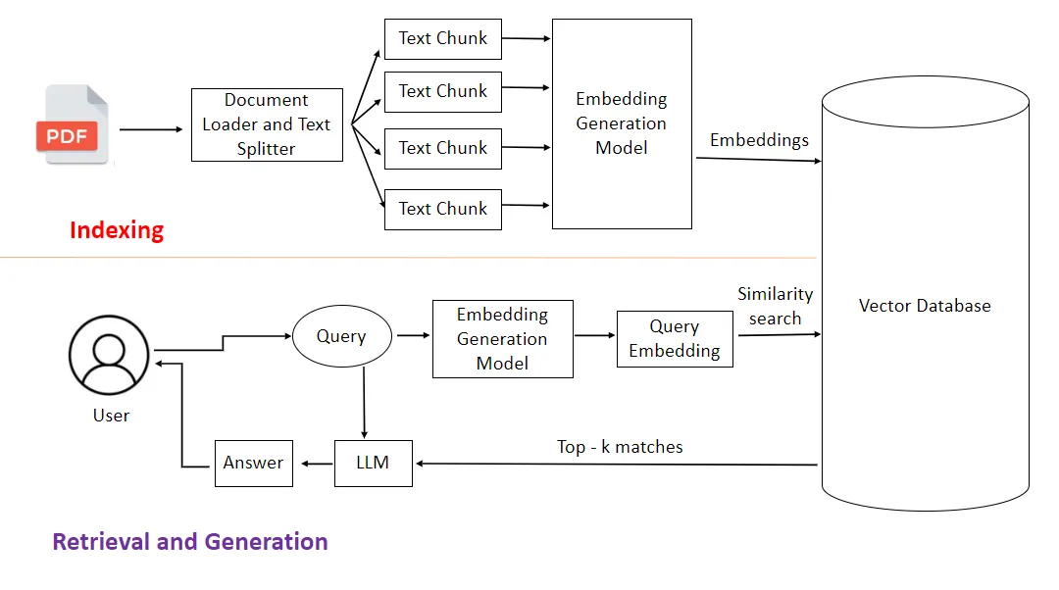
TOOLS AND TOOL CALLING: Retrieval-Augmented Generation
A simple RAG, system:
Receives the content
Splits documents into chunks
Turns chunks into embeddings
Stores those embeddings in a vector database
Embeds the user’s query
Compares the query vector to all stored chunk vectors
Retrieves the closest chunks using a bi-encoder
If your document contains:
“Residents were advised to avoid low-lying roads.”
“Flood barriers were deployed near the river.”
and the query is:
“What were people told to do during flooding?”
The query embedding should be close to the first chunk embedding.
That is how the system finds relevant text even if the wording differs.

Slide 36
TOOLS AND TOOL CALLING: Retrieval-Augmented Generation
Example of retrieval logic
Document chunks:
Chunk 1:
“Residents were advised to avoid low-lying roads.” becomes : [0.8, 0.1, 0.3]
Chunk 2:
“The stock market rose in afternoon trading.” becomes : [-0.4, 0.9, −0.2]
User query:
“What safety advice was given during the flood?” becomes : [0.75, 0.15, 0.28]
The query vector is much closer to Chunk 1 than Chunk 2, so Chunk 1 is retrieved.

Slide 37
TOOLS AND TOOL CALLING: Retrieval-Augmented Generation
RAG Limitations
Similar wording can still be misunderstood
Domain-specific terminology may be poorly represented
Very small chunks may lose context
Very large chunks may blur meaning
Embeddings can confuse related but distinct ideas
They are not perfect for exact factual matching
Some content may not be retrieved
A simple vector search might be insufficient at scale

Slide 38
TOOLS AND TOOL CALLING: Retrieval-Augmented Generation
Reranker is a secondary model used to refine the results of an initial search.
Vector/Semantic search is great at quickly narrowing down millions of chunks to a "top 100"
It lacks precision
Reranker is more computationally expensive
Can be used as the second filter to improve precision
Cross-Encoders
It processes the Query and the Document together in a single pass through the Transformer model. It uses "Full Attention," meaning every word in the query is compared directly to every word in the document(chunk).
Bi-Encoders
How it works: Instead of a single vector representing a whole document, it uses "Late Interaction." It stores multiple vectors for every token (word) in a document. During reranking, it performs a fast alignment check between query tokens and document tokens.

Slide 39
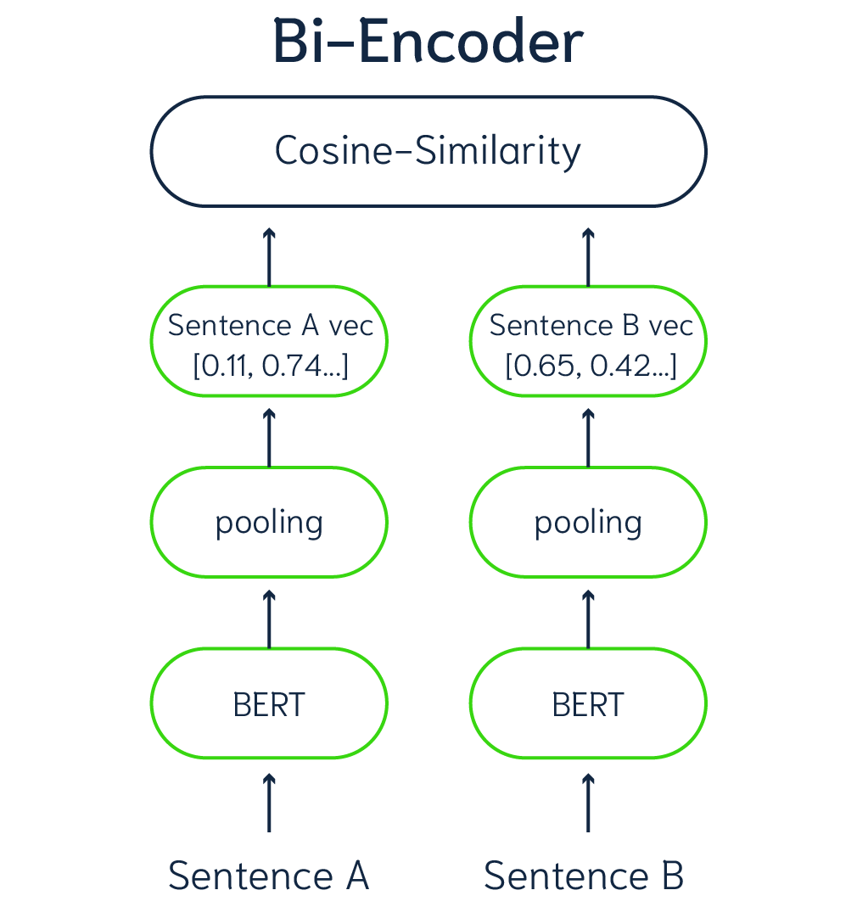
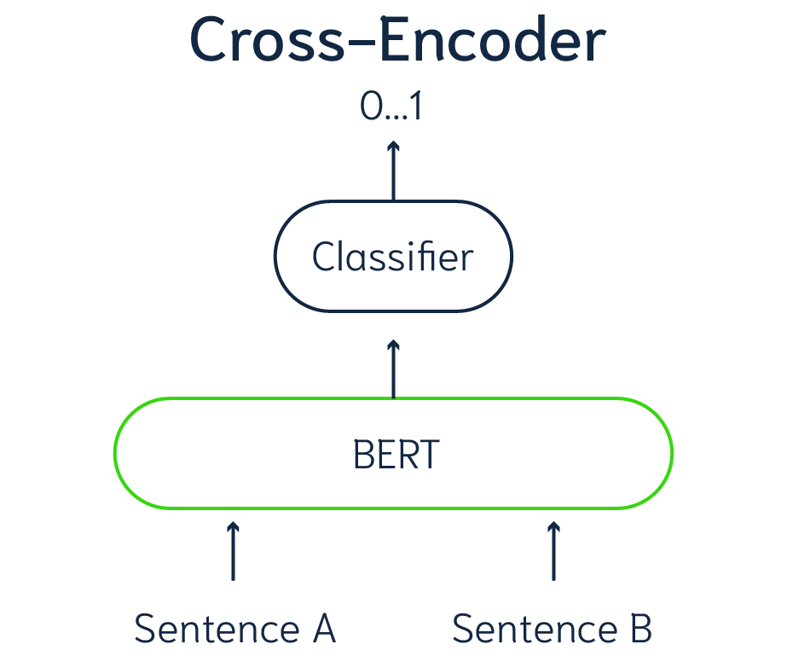
TOOLS AND TOOL CALLING: Retrieval-Augmented Generation
* BERT (Bidirectional Encoder Representations from Transformers) is a Transformer-based model developed by Google AI for Natural Language Understanding (NLU).

Slide 40
TOOLS AND TOOL CALLING: Retrieval-Augmented Generation
 | Bi-Encoder | Cross-Encoder
Input | Sentences processed separately | Both sentences fed in together
Output | Two vectors → cosine similarity | One direct score (0–1)
Accuracy | Good | Higher (sees full context of both)
Speed | Fast (pre-compute embeddings) | Slow (must re-run for every pair)
Scalable to large datasets? | Yes | No

Slide 41
TOOLS AND TOOL CALLING: Retrieval-Augmented Generation
Bi-Encoder vs Cross-Encoder:
Task: Find the most relevant document for the query "What is the capital of France?”
Documents:
"Paris is the capital and largest city of France."
"France is known for its wine and cuisine."
"The Eiffel Tower is a famous landmark."

Slide 42
TOOLS AND TOOL CALLING: Retrieval-Augmented Generation
Bi-Encoder
Each text is encoded independently into a vector (embedding), then similarity is measured after the fact.
Query → Encoder →[0.12, 0.87, 0.45, ...]
Doc 1 → Encoder →[0.11, 0.85, 0.46, ...] → 0.98
Doc 2 → Encoder →[0.60, 0.20, 0.71, ...] → 0.41
Doc 3 → Encoder →[0.55, 0.30, 0.60, ...] → 0.38
The query and each document go through the encoder separately, producing fixed vectors.
Similarity is just a dot product / cosine
very cheap.

Slide 43
TOOLS AND TOOL CALLING: Retrieval-Augmented Generation
Cross-Encoder
The query and document are concatenated and fed together into the model, which outputs a single relevance score.
Compares:
“What is the capital of France? “And “Paris is the capital and largest city of France.”
[Query + Doc 1] → Encoder → score: 0.97 ✅
[Query + Doc 2] → Encoder → score: 0.21
[Query + Doc 3] → Encoder → score: 0.35
The model attends to both texts simultaneously via self-attention, capturing rich interactions (e.g., it notices "capital" in the query directly relates to "capital" in Doc 1).
The model can directly compare words across the query and document.
Much more accurate, but slower
Notes:
[SEP] — The Separator Token
This one is straightforward. It's just a boundary marker that tells the model "one sequence ends here, another begins."
[CLS] What is the capital of France? [SEP] Paris is the capital of France. [SEP]
↑___ sequence A ___________↑ ↑___ sequence B ______________↑
The second [SEP] at the end just marks the end of the whole input. Without [SEP], the model wouldn't know where the query stops and the document begins — it would just see one long stream of tokens with no structure.
[CLS] — The Classification Token
This is the more interesting one. [CLS] stands for classification, and it's prepended to the very start of every input. It starts as a meaningless placeholder, but something important happens to it during the forward pass.
Because transformers use self-attention, every token attends to every other token. The [CLS] token has no word meaning of its own, so it has no "agenda" — it freely absorbs information from all other tokens across all layers.
Layer 1: [CLS] weakly attends to everything
Layer 2: [CLS] starts picking up query-document relationships
Layer 3: [CLS] accumulates richer semantic signal
...
Layer 12: [CLS] now contains a compressed summary of the entire input pair
By the final layer, [CLS] has essentially become a summary vector of the whole sequence. You then take just that one vector and pass it through a small linear layer to get your score:
[CLS] final vector → linear layer → 0.97 (relevance score)

Slide 44
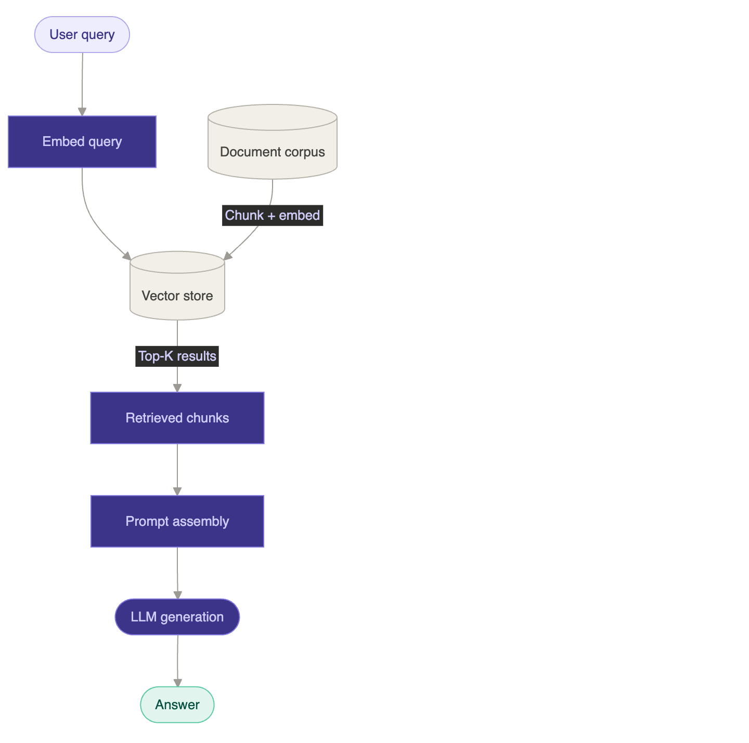
TOOLS AND TOOL CALLING: Retrieval-Augmented Generation
RAG 1 — Embedding only. The query is embedded, top-K chunks are pulled from the vector store by cosine similarity, and everything goes straight to the LLM. Fast and simple.

Slide 45
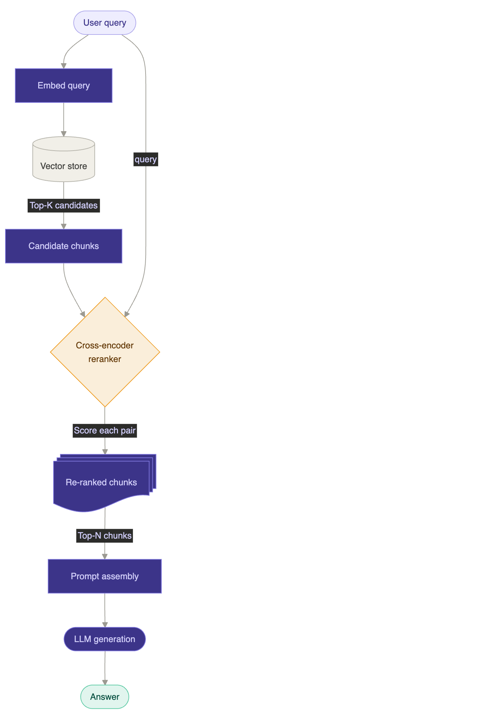
TOOLS AND TOOL CALLING: Retrieval-Augmented Generation
RAG 2 — With cross-encoder reranking. A bi-encoder does a fast first-pass retrieval (top-K), then a cross-encoder scores every (query, chunk) pair jointly much more accurate but slower. Only the top-N reranked chunks go to the LLM, cutting noise significantly.

Slide 46
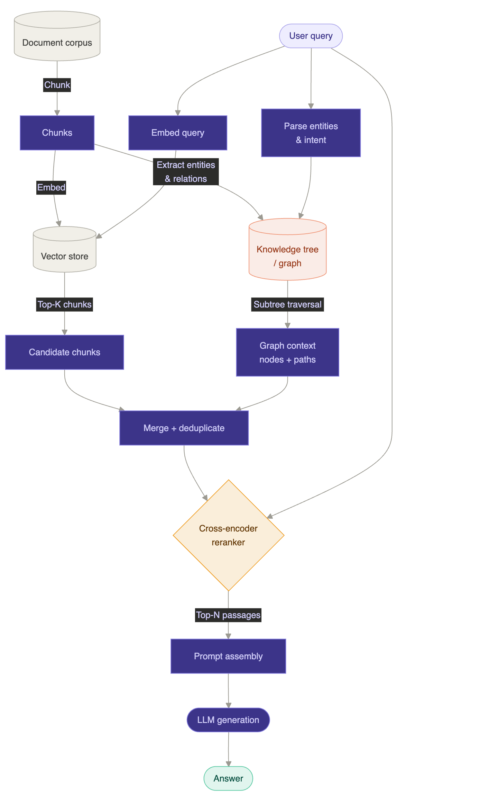
TOOLS AND TOOL CALLING: Retrieval-Augmented Generation
RAG 3 — With knowledge tree + reranking
Chunk documents into passages (same as RAG 1 & 2)
Embed every chunk → stored in a vector store
Run entity + relationship extraction → "Tesla — faced — bankruptcy risk"
Stitch all entities and relationships into a knowledge graph
Embed every graph node so it's searchable by similarity
Cluster the graph into communities, LLM-summarise each cluster → summaries also stored in the vector store

Slide 47
TOOLS AND TOOL CALLING: Retrieval-Augmented Generation
RAG 3 Query time — two parallel retrieval paths
Vector path → finds chunks and community summaries similar to the query
Graph path → parses query entities, finds entry nodes, traverses 2–3 hops to collect connected facts and relationship labels
Both paths merge → cross-encoder reranker scores everything → top-N go to the LLM
What the LLM actually receives
Raw text passages (from vector path) → the facts
Graph triples and traversal paths (from graph path) → the narrative connecting those facts
Community summaries → pre-synthesised big-picture context

Slide 48
TOOLS AND TOOL CALLING: Retrieval-Augmented Generation
RAG 3 Indexing — building the system
When to use it
Questions that span multiple documents or require multi-hop reasoning
Complex domains with rich entity relationships (research, legal, medical)
When RAG 1 & 2 are visibly failing on "overview" or "how does X relate to Y" questions

Slide 49
TOOLS AND TOOL CALLING: DYNAMIC TOOL CALING
The Problem: Static Tool Definitions
Standard approach: define every tool upfront in the system prompt
Works fine for 5–6 tools
Breaks down as toolsets grow
Three failure modes: context saturation, degraded accuracy, compounding costs
Context Window Saturation
A typical 5-server MCP setup consumes ~55,000 tokens before conversation starts
Adding one server (e.g. Jira at ~17,000 tokens) can push overhead past 100,000
Anthropic internally observed 134,000 tokens consumed — half the context window — before the user typed a word
GitHub's MCP server alone (91 tools) uses ~25% of the context window

Slide 50
TOOLS AND TOOL CALLING: DYNAMIC TOOL CALING
Degraded Accuracy & Rising Costs
Tool selection accuracy degrades significantly beyond 30–50 tools
Failure modes: wrong tool picked, parameter hallucination, tool interference
With 40+ tools: 68% task completion, 23% hallucination rate
After filtering to relevant tools: 89% completion, 8% hallucination
A 20-turn conversation with 55K tokens of tool overhead reprocesses over 1.1M tokens

Slide 51
TOOLS AND TOOL CALLING: DYNAMIC TOOL CALING
The Solution: Dynamic Tool Loading
Give the model access to a large tool library
Inject only the relevant tools into each request
Also known as "Tool RAG" (by analogy with Retrieval-Augmented Generation)
Core idea: decouple what the agent can do from how it decides what to do

Slide 52
TOOLS AND TOOL CALLING: DYNAMIC TOOL CALING
Two sides of dynamic tool loading
Part 1 — Dynamic registration
Tools are registered automatically via decorators + inspect
No hand-written schemas, no manual config files
Adding a tool = writing a function and dropping it in the tools directory
The registry re-indexes and the new tool is immediately discoverable
Part 2 — Dynamic retrieval
When a query arrives, only relevant tools are fetched from the registry
The retriever scores every tool against the query (BM25, embeddings, or hybrid)
Top 3–5 matches are injected into the prompt — the rest stay hidden
The LLM works with a clean, focused context every time
One side solves the developer experience (fast tool creation)
The other solves the model experience (accurate tool selection)

Slide 53
TOOLS AND TOOL CALLING: DYNAMIC TOOL CALING
Three-Component Architecture
Registry — Central catalogue of all tools (source code as single source of truth)
Retriever — Searches the registry per query, returns only relevant tools
Injector — Converts selected tools into JSON schemas for the API call

Slide 54
TOOLS AND TOOL CALLING: DYNAMIC TOOL CALING
Flow
User Query → "Will I need an umbrella in Melbourne?"
Retriever → Searches tool docstrings via BM25 / embeddings → returns top 2–3 matches
Injector → Converts matched functions into JSON tool schemas
LLM API Call → System prompt + user message + only the 2–3 relevant tool definitions
Model Response → Selects and calls the right tool, returns answer

Slide 55
TOOLS AND TOOL CALLING: DYNAMIC TOOL CALING
Retrieval Methods Compared
BM25 (keyword) — 91.6% recall, <5ms, CPU only, no training needed
Vector (embedding) — 96.8% recall, 10–50ms, handles synonyms & paraphrases
Hybrid (BM25 + vector) — ~97–99% recall, 15–60ms, best overall accuracy
Production implementations return 3–5 tools from catalogues of up to 10,000
Results: Static vs. Dynamic
Token overhead: ~55,000 → ~3,000 (85% reduction)
Opus 4 accuracy: 49% → 74%
Opus 4.5 accuracy: 79.5% → 88.1%
Task completion: 68% → 89%
Hallucination rate: 23% → 8%
Practical tool limit: 5–10 → hundreds to thousands

Slide 56
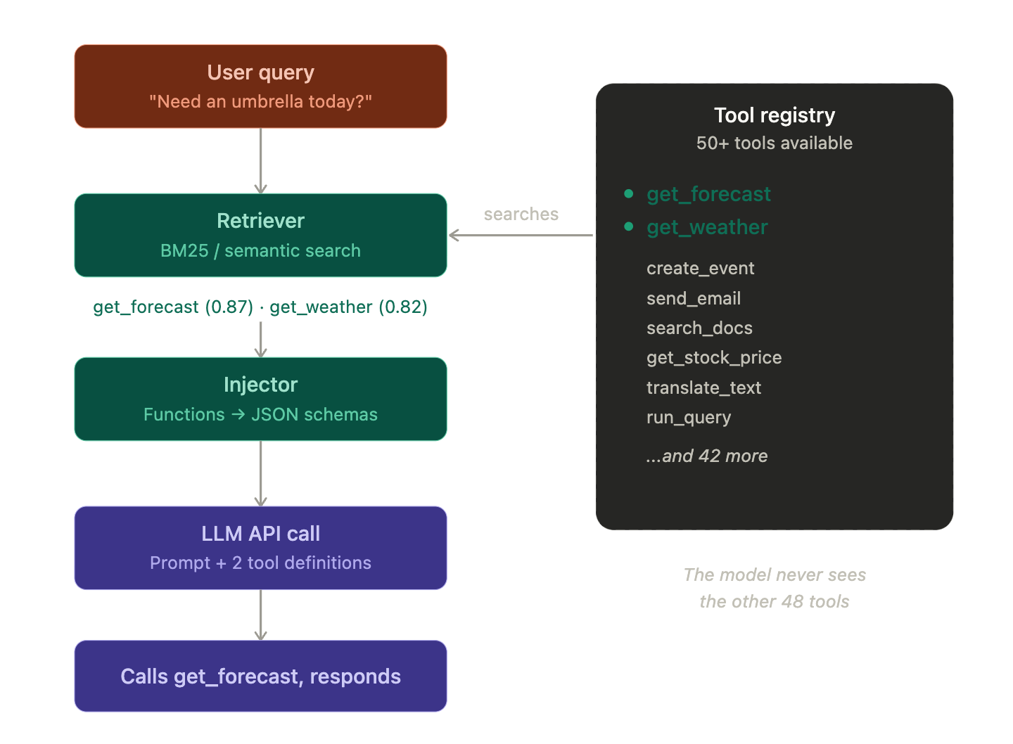
TOOLS AND TOOL CALLING: DYNAMIC TOOL CALING

Slide 57
TOOLS AND TOOL CALLING: DYNAMIC TOOL CALING
How Tools Are Registered and Converted
@tool decorator marks a function as available to the agent
The inspect module reads each function's signature, type hints, and docstring automatically
Docstrings serve double duty: guide the retriever on when to match, and tell the LLM how to use the tool
inspect.signature() extracts parameter names, types, and defaults
Parameters without defaults are marked as required in the schema
Type hints (str, int, bool, float) map directly to JSON Schema types
The output is a clean JSON tool definition the LLM API expects — generated, never hand-written
Source code is the single source of truth: update the function, the schema updates with it

Slide 58
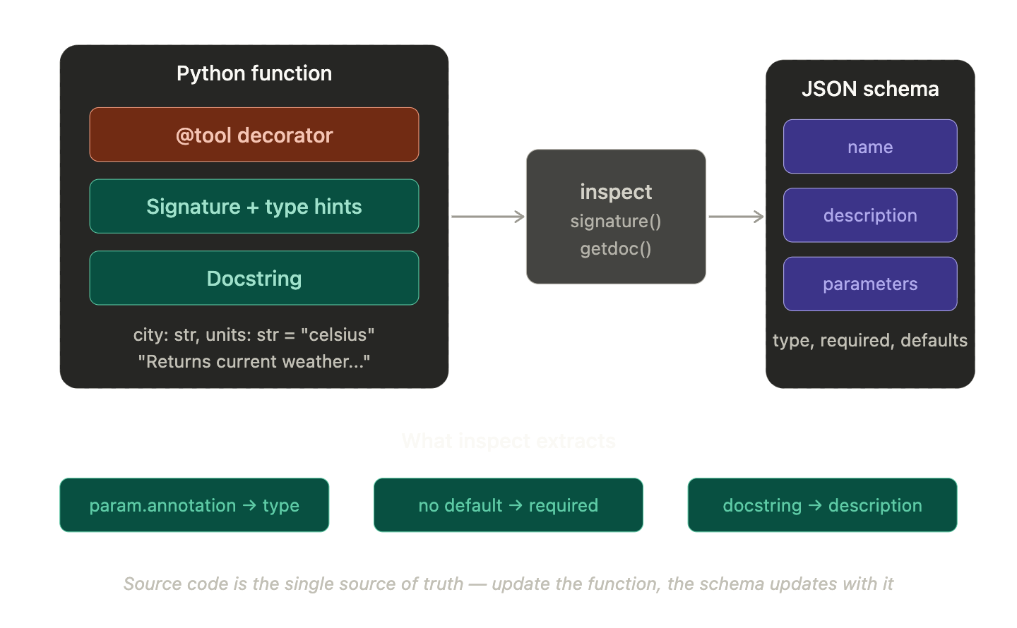
TOOLS AND TOOL CALLING: DYNAMIC TOOL CALING

Slide 59
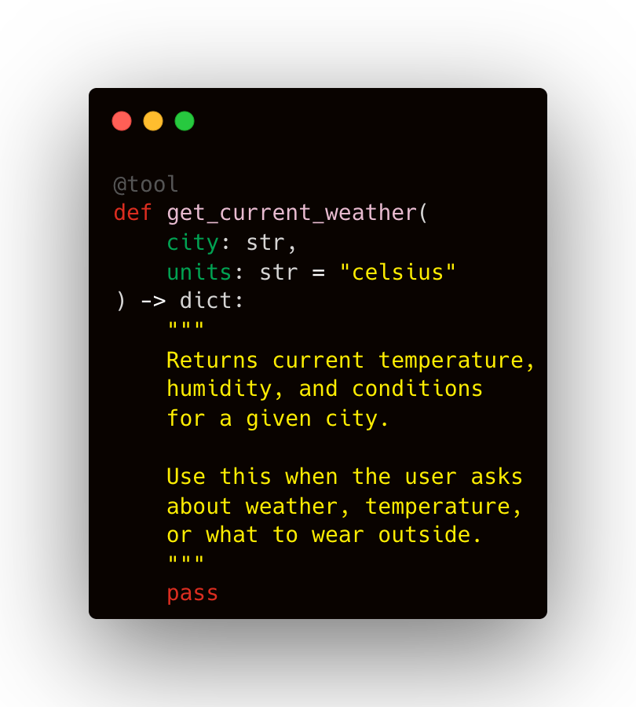
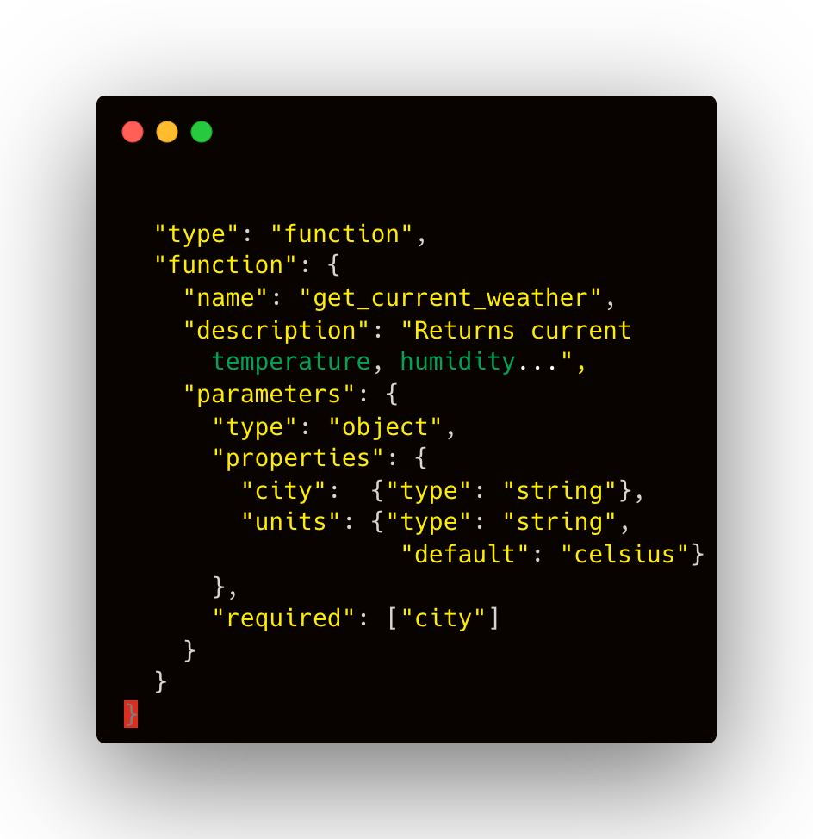
TOOLS AND TOOL CALLING: DYNAMIC TOOL CALING

Slide 60
LARGE LANGUAGE MODEL

Slide 61
LARGE LANGUAGE MODEL
LLM is the component that:
Reasons over context
Decides next action
Generates text or structured outputs
Uses tools through the runtime

Slide 62
LARGE LANGUAGE MODEL: MODEL SELECTION
How do we choose the right model for an agentic system?
Reasoning capability
Tool-calling reliability
Instruction following
Structured output reliability
Context window needs
Latency
Cost
Multimodal support
Coding ability

Slide 63
LARGE LANGUAGE MODEL: MODEL SELECTION
Many open weight and closed models are available
Closed models:
Usually accessed through provider API:
OpenAI, Anthropic, Google
Good
They are easier to use.
Often have stronger managed tooling, and reduce infrastructure burden.
Current hosted model platforms expose capabilities like built-in tools, structured outputs, streaming, and managed APIs directly.
More intelligent.
Bad
API Cost
Less control on the model.
Less privacy
Dependence on the provider

Slide 64
LARGE LANGUAGE MODEL: MODEL SELECTION
Open-weight models
These models give you more control over deployment and may be self-hosted, fine-tuned, and can be integrated into your own infrastructure.
Good
Free
Private
Better control
Bad
Harder to setup
Can be computationally demanding
Can be Less intelligent than SOTA models

Slide 65
LARGE LANGUAGE MODEL: MODEL SIZE
A parameter is a learned numerical value inside the model. During training, the model adjusts billions of these values to capture patterns in language and other data.
7B model
20B model
70B model
120B model
They usually mean roughly:
7 billion parameters
20 billion parameters
70 billion parameters
Size usually means parameter count
more parameters often means more capacity (not always)
larger models cost more to run
larger models need more memory
model size is only one decision factor

Slide 66
LARGE LANGUAGE MODEL: QUANTIZATION
Quantization is the process of storing and sometimes computing model values using lower numerical precision, so the model uses less memory and can often run faster.
Hugging Face defines quantization as lowering memory and computational costs by representing weights and activations with lower-precision data types such as 8-bit integers, instead of higher-precision formats like fp32, while trying to preserve as much accuracy as possible.
Quantization shrinks the model’s numerical representation.
The goal is to make large models easier to load and run on limited hardware.

Slide 67
LARGE LANGUAGE MODEL: QUANTIZATION
Why does quantization matter?
Suppose a model has billions of parameters. Each parameter must be stored as a number. If each number is stored with high precision, the model consumes a lot of memory. If those same numbers are stored with fewer bits, the model becomes much smaller in memory.
Quantization enables loading larger models that otherwise would not fit in memory.
Before quantization, model weights are commonly stored in formats like:
fp32: 32-bit floating point
fp16: 16-bit floating point -> the precision that is sometimes used for deployment
bf16: 16-bit floating point -> precision used for training
Quantized formats often go lower, such as:
int8: 8-bit integers
int4: 4-bit representations

Slide 68
LARGE LANGUAGE MODEL: QUANTIZATION
What is being quantized?
Model’s weights
The benefit is lower memory use and often faster inference.
The cost is that some information is lost because numbers are represented less precisely. Quantization can introduce some accuracy loss.
More quantization → smaller and faster
Less quantization → larger and often more accurate
a 7B model is still a 7B model
The actual file size and RAM/VRAM requirement can differ depending on whether it is fp16, int8, 4-bit, GGUF, and so on
*GGUF, which stands for GPT-Generated Unified Format, is a modern file format created to store and run LLMs efficiently,

Slide 69
LARGE LANGUAGE MODEL: LOCAL MODELS
For downloading open weight resources, NLP algos and opensource ML systems, Hugging face is a great place to start:
Great community support
Many LLMs models and their community forks can be found there: derestricted models, etc.
Ollama
Simplest setup experience
get running in minutes with a single command
Strong and active community with good documentation and plugin support
Supports both local and cloud inference, with a freemium model for cloud use
LM Studio
Fine-grained model control via a polished GUI
adjust parameters without touching config files
Broader model library with direct access to Hugging Face models
Superior GPU/CPU offloading optimization, resulting in noticeably faster inference than Ollama on the same hardware

Slide 70
LARGE LANGUAGE MODEL: LOCAL MODELS
vLLM
Purpose-built for high-throughput, production-grade serving — not just local experimentation
Uses PagedAttention and continuous batching to dramatically maximize GPU memory efficiency
Supports multi-GPU and multi-node distributed inference out of the box
Exposes an OpenAI-compatible REST API, making it drop-in ready for existing toolchains
llama.cpp
Designed for running LLMs on consumer hardware
CPUs, laptops, and edge devices with little to no GPU required
Uses aggressive quantization (2-bit to 8-bit) to compress model weights, slashing memory requirements while preserving most of the model's quality
Written in pure C/C++ with zero dependencies, making it extremely portable across Windows, macOS and Linux
Powers most local AI tools (Ollama, LM Studio, Jan) under the hood
it is effectively the inference engine of the local-AI ecosystem

Slide 71
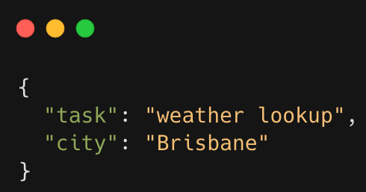
LARGE LANGUAGE MODEL: JSON
JSON stands for JavaScript Object Notation. It is a plain text format for storing and exchanging structured data.
JSON is just a standardized way to organize and transport data so that different systems can understand each other.

Slide 72
LARGE LANGUAGE MODEL: JSON
Where JSON is Used in Agentic Systems
Tool arguments: passing inputs to tools the agent calls
Structured outputs: ensuring the model returns data in a predictable format
Configuration: defining system settings and parameters
API payloads: packaging data sent to and received from external services
Workflow state: tracking what has happened and what comes next
Message exchange: standardizing communication between components
Why JSON Matters for Agents
Outputs can be validated: bad or malformed data gets caught before it causes issues
Applications can read exact fields : no guessing or parsing free-form text
Tools can be called safely and predictably: the agent knows exactly what to pass and what to expect back

Slide 73
LARGE LANGUAGE MODEL: JSON
LLM initially doesn’t know how to generate reliable tool since it doesn’t know the JSON schema required for tool calling. We need to explain:
what tools are available
when to call them
how to call them
Tool Schemas as Contracts
A tool schema is a formal contract between the agent and the outside world
it specifies what the agent must provide and what it will receive back
Defined in JSON Schema:
Field names,
Data types,
Required fields
Acceptable value ranges
The LLM reads the schema at inference time and uses it to construct a valid call

Slide 74
LARGE LANGUAGE MODEL: JSON
Memory and State via JSON
Agents are stateless by default
Each LLM call has no memory of previous calls unless state is explicitly passed in
Workflow state is serialised as JSON and injected into each prompt
What steps have run, what results were returned, what the current goal is
Short-term memory: the running conversation and tool result history, kept in the context window
Long-term memory: facts and past interactions stored in a vector database or key-value store, retrieved by similarity at query time
Checkpointing state as JSON also makes agent workflows resumable after failures
the agent can re-read its last state and continue

Slide 75
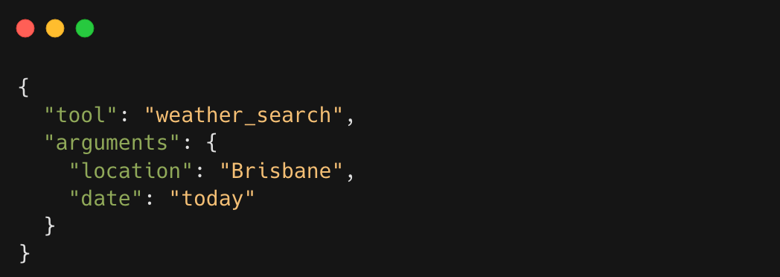
LARGE LANGUAGE MODEL: JSON
Example:
“Search Brisbane weather and tell me if it is cloudy.”

Slide 76
WORKFLOW/ORCHESTRATION

Slide 77
ORCHESTRATION: WHAT IS IT?
Orchestration is the control logic that coordinates how the components of an agentic system interact over time.
It determines:
what step happens first
what step happens next
when a tool should be called
when retrieval should happen
when another model or agent should be involved
when the system should stop
It is the logic that coordinates the system.

Slide 78
ORCHESTRATION: WHY IT MATTERS
Without orchestration, you just have separate parts:
LLM
Some tools
Nothing tells them:
In what order to run
Under what conditions to run
How outputs should move between them
How long the process should continue
What to do if something fails

Slide 79
ORCHESTRATION: WHAT IT CONTROLS
Task sequencing
Receive user request
Classify the task
Retrieve information if needed
Call the LLM
Call a tool if required
Inspect the result
Continue or stop
It controls iteration
Example:
Search for sources
Inspect quality of results
If evidence is weak, search again
Then answer

Slide 80
ORCHESTRATION: WHAT IT CONTROLS
Multi-agent coordination
Example:
planner agent breaks down the task
researcher agent gathers evidence
critic agent checks quality
writer agent produces the final output
Stopping conditions decides when the system is done.
Example stop rules:
enough evidence has been gathered
final answer has been produced
max number of steps reached
timeout reached
tool failed too many times
human approval required before continuing

Slide 81
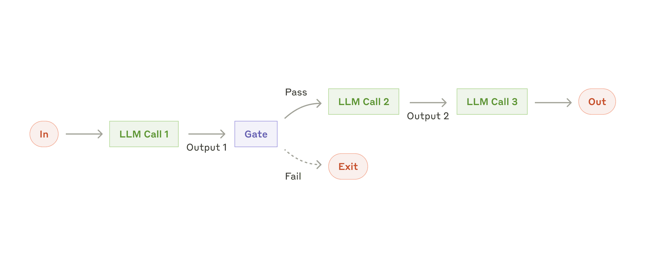
SOME WORKFLOW EXAMPLES
Prompt chaining
Decompose a task into a sequence of steps, where each LLM call processes the output of the previous one. The main goal is to trade off latency for higher accuracy, by making each LLM call an easier task.

Slide 82
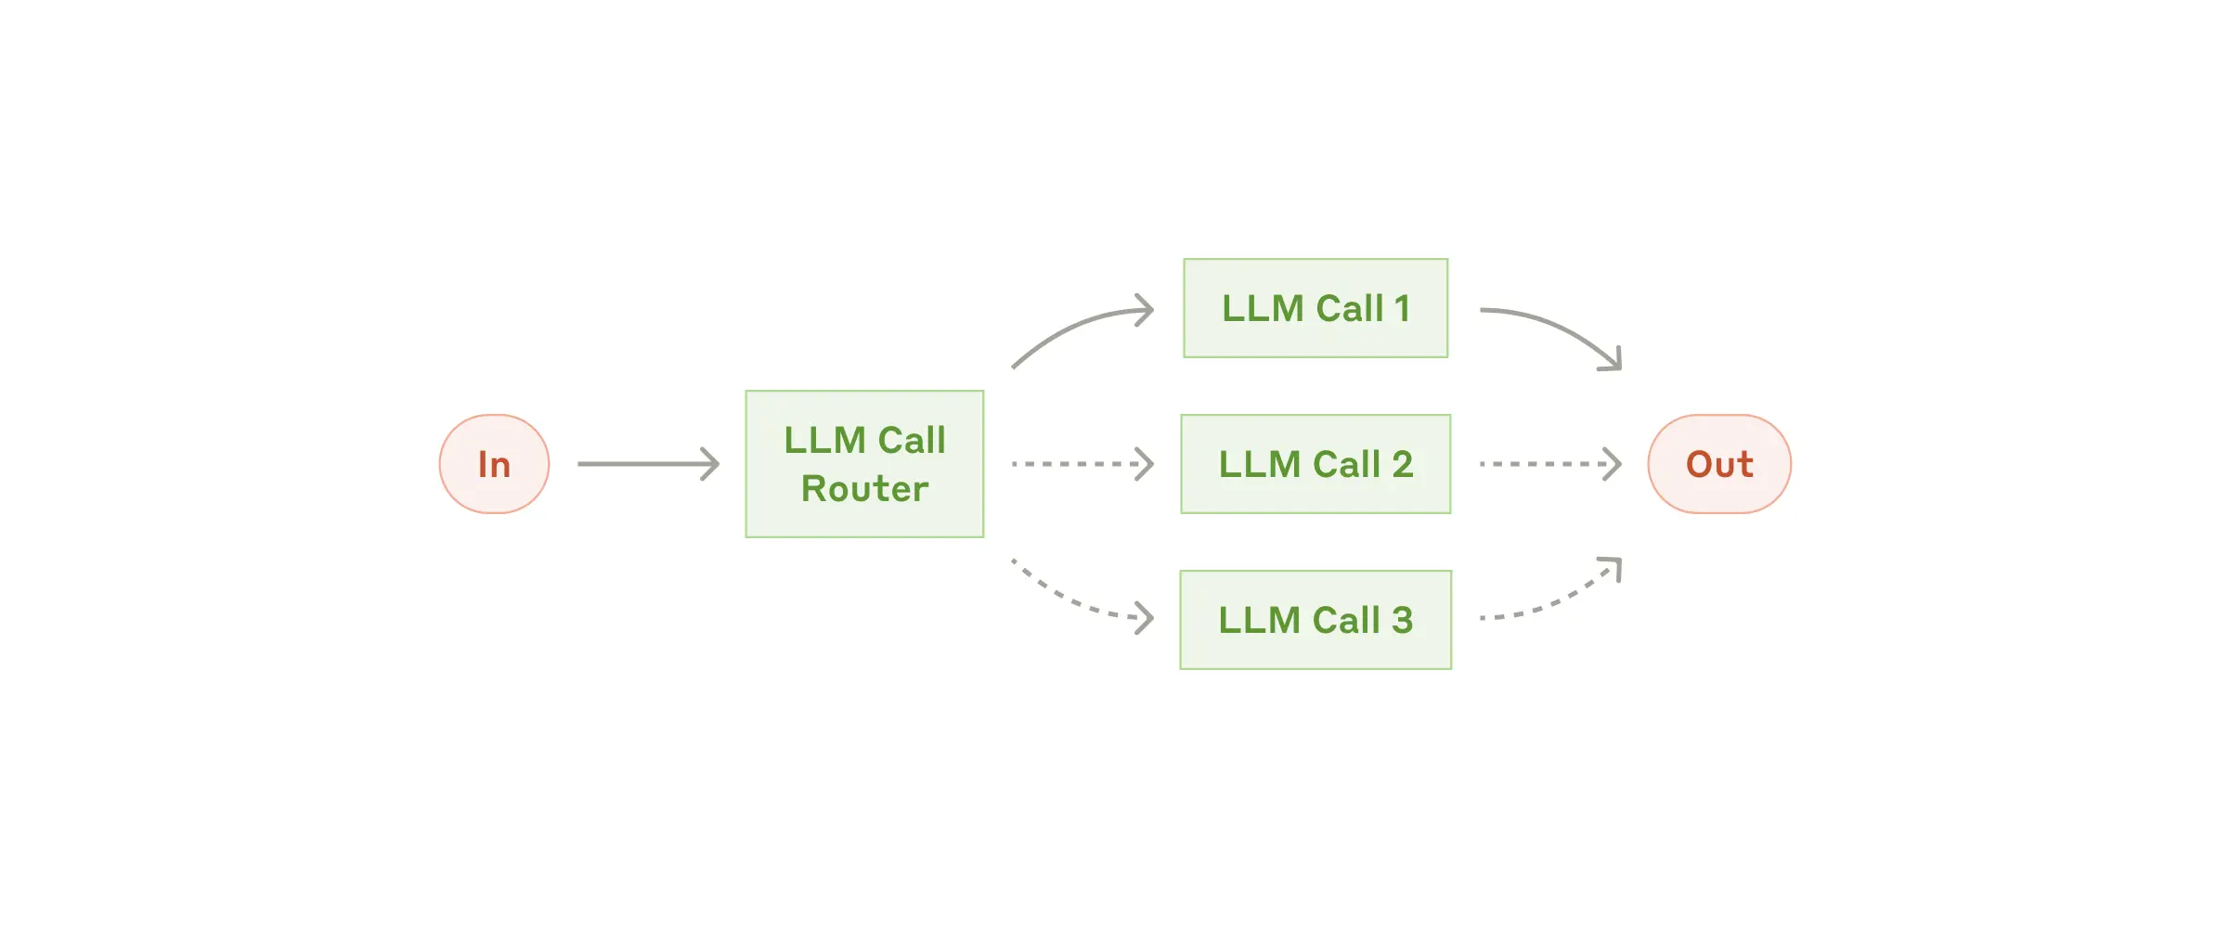
SOME WORKFLOW EXAMPLES
Routing
Routing classifies an input and directs it to a specialised follow-up task. This workflow allows for separation of concerns, and building more specialized prompts. Without this workflow, optimizing for one kind of input can hurt performance on other inputs.

Slide 83
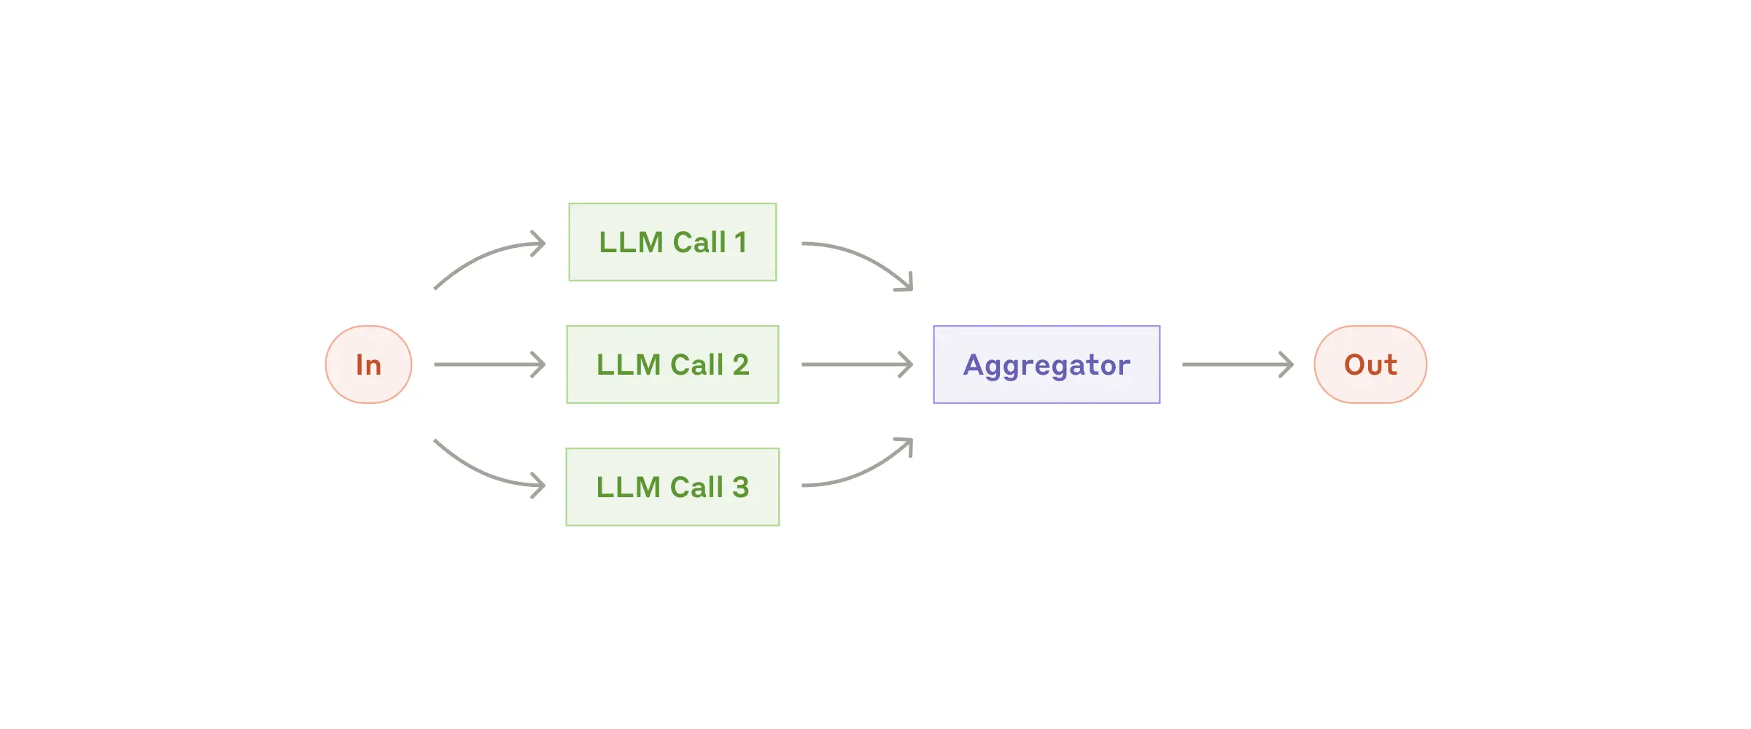
SOME WORKFLOW EXAMPLES
Parallelization
LLMs can sometimes work simultaneously on a task and have their outputs aggregated programmatically. This workflow, parallelization, manifests in two key variations:
Sectioning: Breaking a task into independent subtasks run in parallel.
Voting: Running the same task multiple times to get diverse outputs.

Slide 84
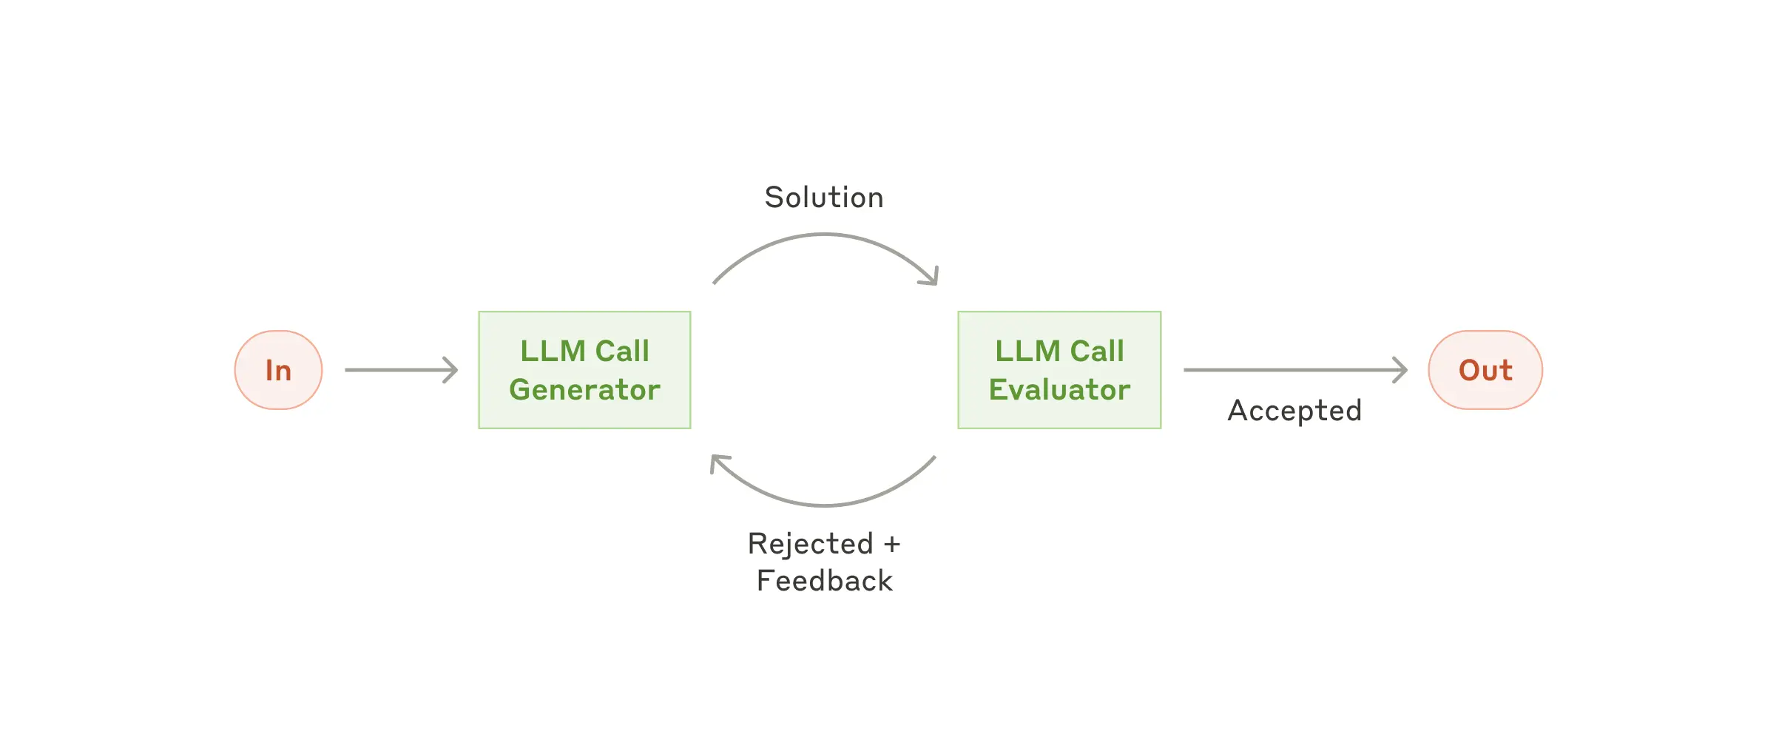
SOME WORKFLOW EXAMPLES
Evaluator-optimizer
One LLM call generates a response while another provides evaluation and feedback in a loop.

Slide 85
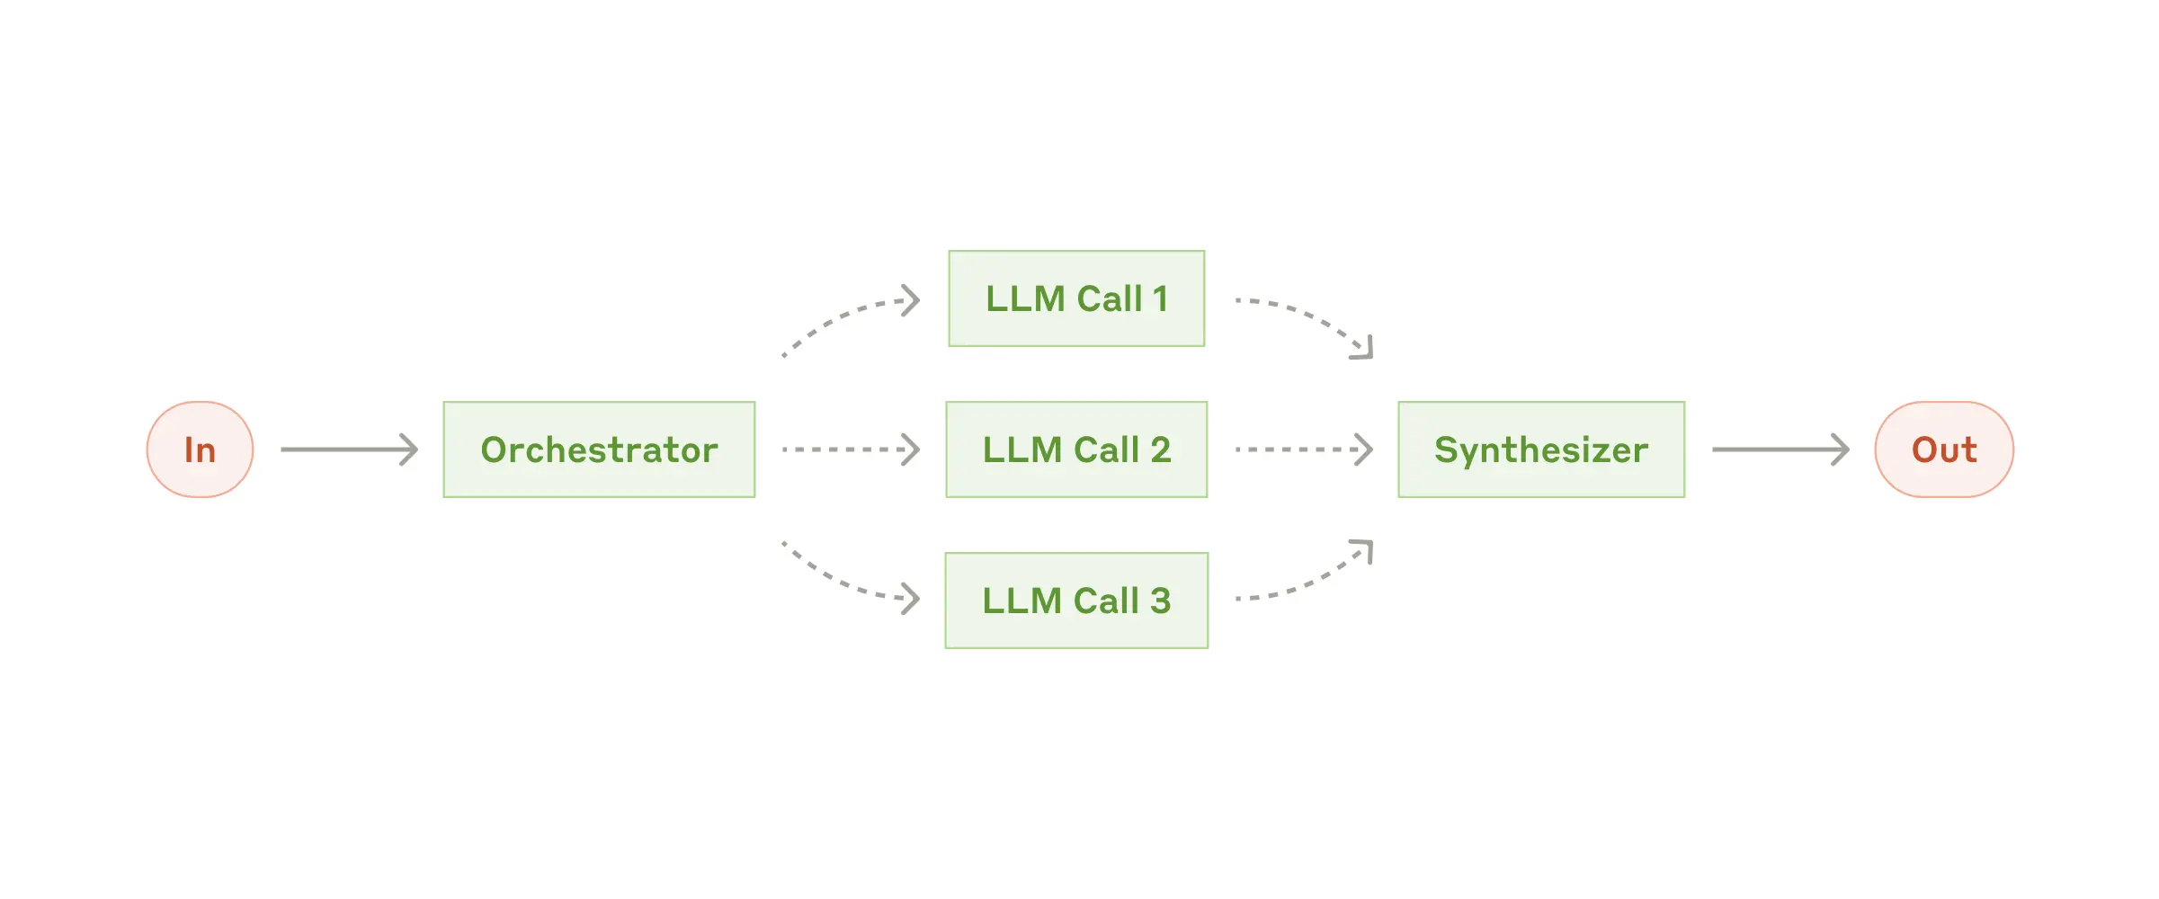
SOME WORKFLOW EXAMPLES
Orchestrator-workers
a central LLM dynamically breaks down tasks, delegates them to worker LLMs, and synthesizes their results.

Slide 86
EXAMPLE of AGENTIC SYSTEM

Slide 87
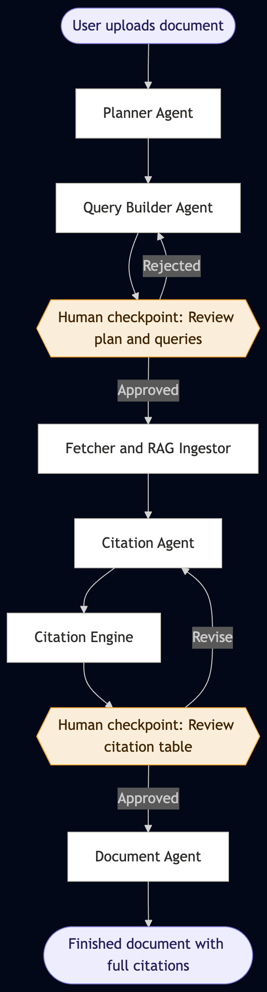
EXAMPLE of an AGENTIC SYSTEM
A multi-agent system that automates the citation and referencing process for academic documents
Six specialised agents work in sequence, each responsible for one stage of the pipeline
Two human checkpoints ensure the researcher stays in control before any irreversible action is taken
Focused on academic text
The system handles the labour; the researcher retains all intellectual judgment

Slide 88
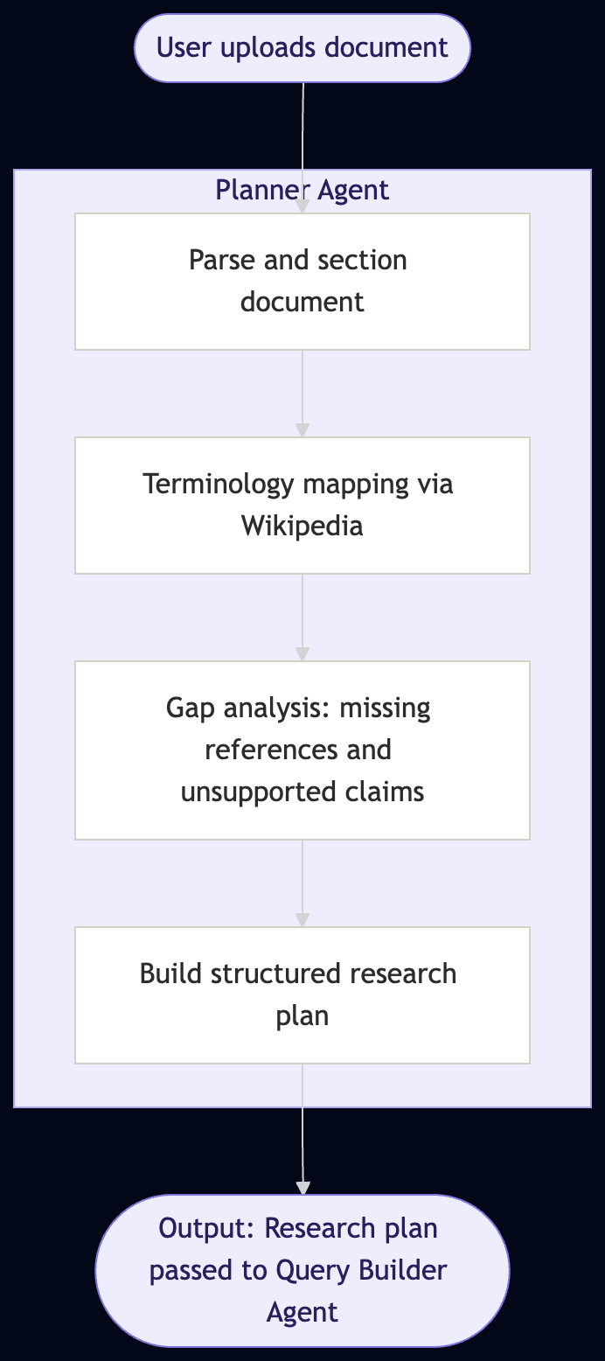
EXAMPLE of AGENTIC SYSTEM
Planner agent
Reads the uploaded document and breaks it into logical sections: Abstract, Introduction, Methods, Results, Conclusion
Queries Wikipedia/web to clarify terminology and map the conceptual scope of the work
Identifies citation gaps
Produces a structured research plan that specifies what topics need coverage, what kind of evidence is required, and which sections are the highest priority
Every downstream agent operates from this plan

Slide 89
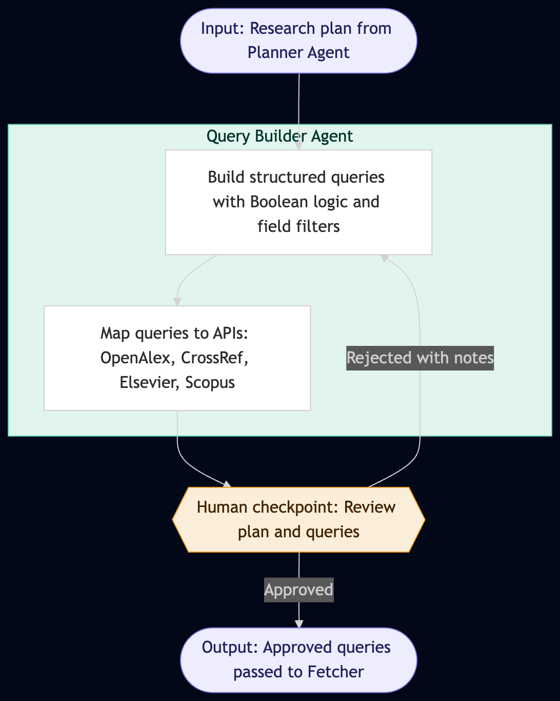
Query Builder Agent
Translates the research plan into, structured API queries
Uses Boolean logic, field-specific filters, and date range constraints to improve retrieval precision
Routes each query to the appropriate database: OpenAlex for open-access literature, CrossRef for DOI resolution, Elsevier and Scopus for paywalled journals
Presents the full query set alongside the research plan to the researcher before the API calls
The researcher can approve, annotate, or reject
rejected queries loop back for refinement with the researcher's notes attached

Slide 90
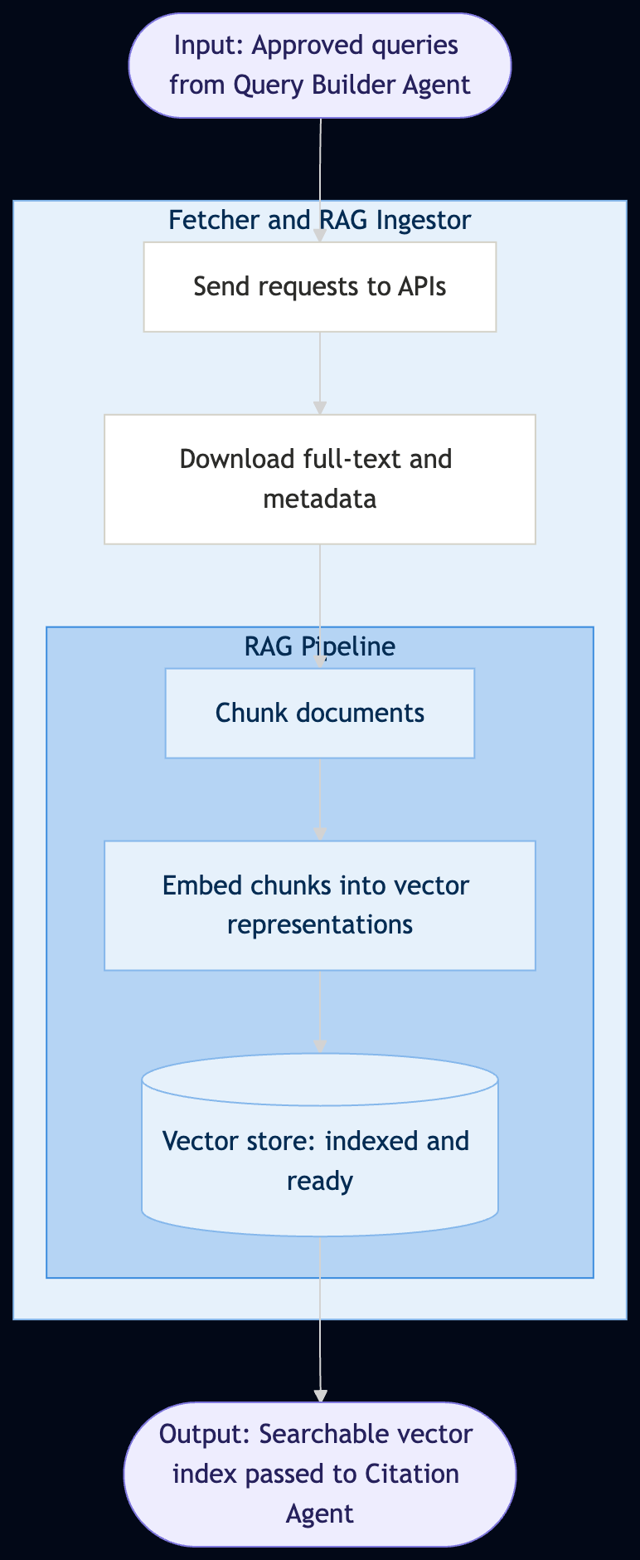
Fetcher and RAG Ingestor
Sends the approved queries to the external APIs and downloads full-text papers and metadata
If the download fails tells user for manual intervention
Chunks each paper into smaller passages
Embeds every chunk into a vector representation, capturing semantic meaning
Stores all embeddings in a vector database
Enables the system to find a relevant passage even when the paper uses different terminology than the original query

Slide 91
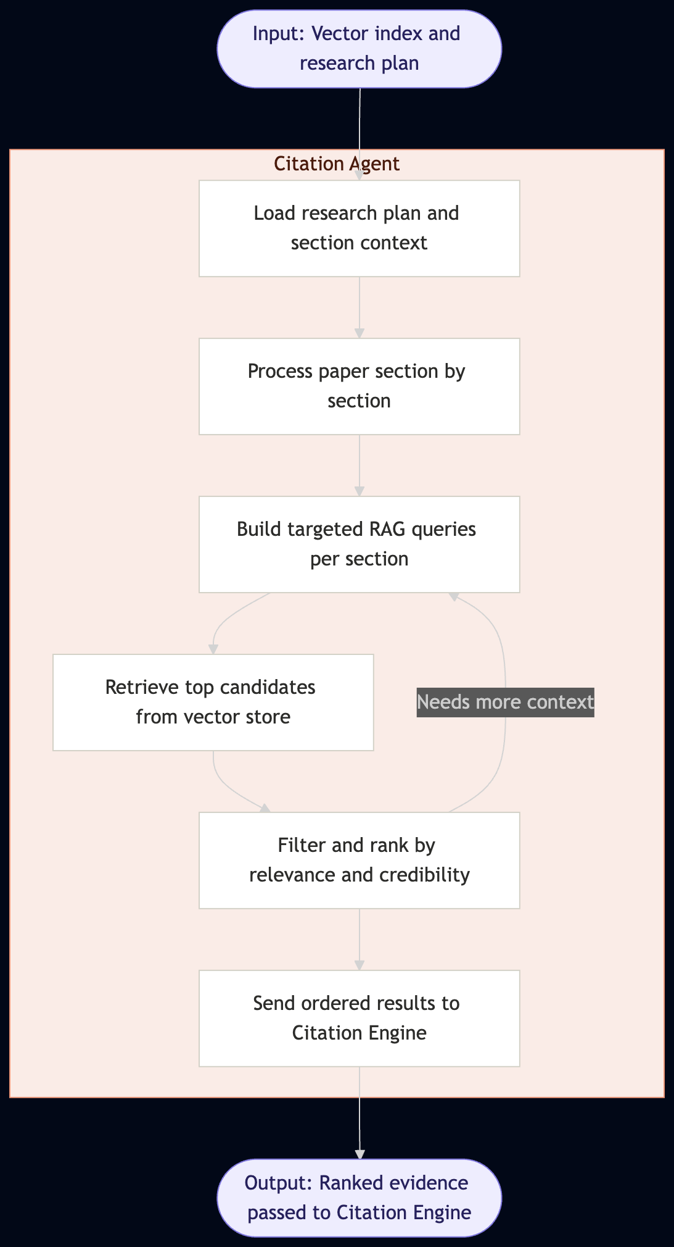
Citation Agent
Works through the uploaded document section by section, keeping the research plan in context at all times
For each section, builds targeted retrieval queries based on the specific claims and arguments present
Searches the vector index and retrieves the semantically relevant passages from the downloaded literature
If the first retrieval pass is insufficient, the agent refines its queries and searches again
Filters and ranks all candidates by relevance, recency, and credibility before passing them forward
Separates the retrieval work from the formatting work
its only job is to find the right evidence

Slide 92
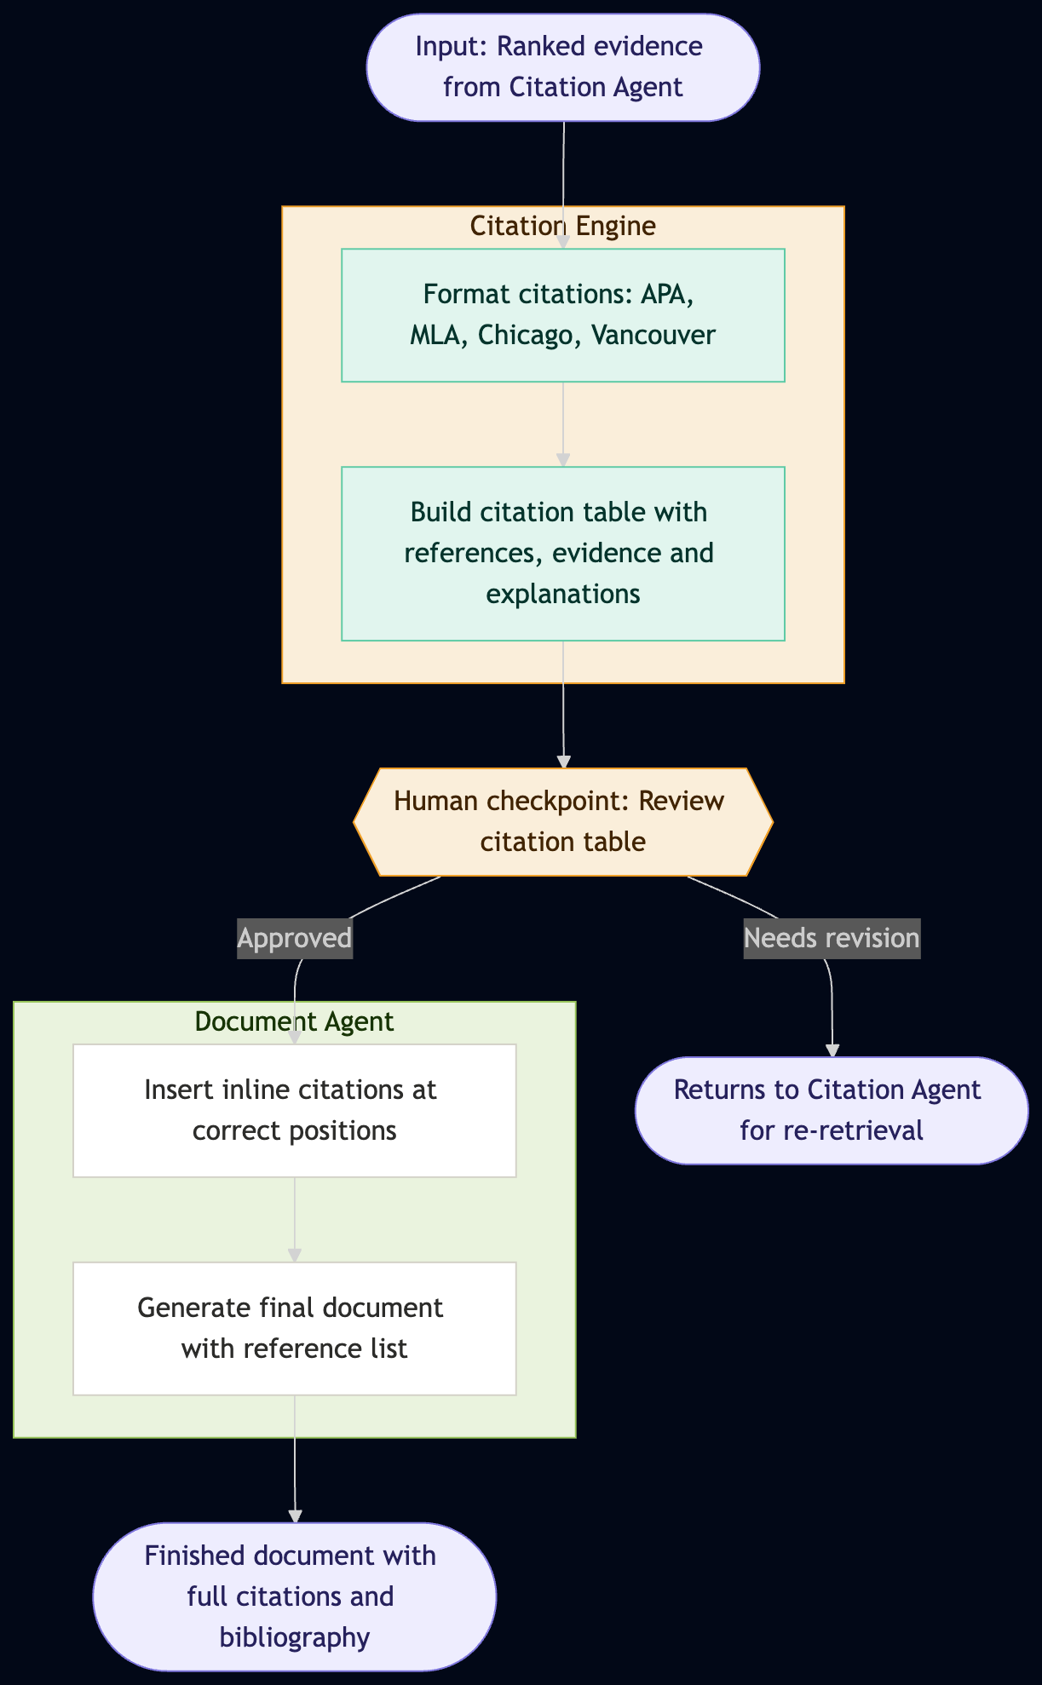
Citation Engine and Document Agent
The Citation Engine receives ranked evidence and formats every reference in the required citation style: APA, MLA, Chicago, or Vancouver
Builds a citation table showing the reference, the exact passage used as evidence, the explanation of why it supports the claim, and the location in the document where it belongs
The researcher reviews the full citation table before anything is written into the document
If any citation needs revision, it loops back to the Citation Agent for re-retrieval rather than requiring manual intervention
Once approved, the Document Agent inserts every inline citation at the precise location identified and appends a complete formatted reference list
The final output is a cited document ready to be reviewed.

Slide 93
OPEN-SOURCE AGENTS

Slide 94
Why use ready-made agents instead of building your own?
In these systems, the agentic flow is already designed for you
Tool selection, memory management, task decomposition, and error recovery are built in
You skip months of orchestration engineering
prompt chaining, retry logic, context management, output parsing
Each agent ships with a tested loop: observe → plan → act → reflect → repeat
Adding a new capability is often just installing a plugin or writing a function — not redesigning the architecture
Multi-turn reasoning, tool calling, and self-correction work out of the box
You focus on your task, not on wiring together LLM calls, API schemas, and state machines

Slide 95
Example:
Hermes Agent
Tools
40+ built-in — web search, terminal, file system, browser automation, vision, image generation, text-to-speech, code execution, subagent delegation, memory, task planning, cron scheduling, multi-model reasoning, and more.
Platforms
Telegram, Discord, Slack, WhatsApp, Signal, Email, and CLI — all from a single gateway. Connect to Nous Portal, OpenRouter, or any OpenAI-compatible API.
Environments
Run locally, in Docker, over SSH, on Modal, Daytona, or Singularity. Container hardening with read-only root, dropped capabilities, and namespace isolation.
Skills
40+ bundled skills covering MLOps, GitHub workflows, research, and more. The agent creates new skills on the fly and shares them via the open agentskills.io format. Install community skills from ClawHub, LobeHub, and GitHub.
Research
Batch trajectory generation with parallel workers and checkpointing. Atropos integration for RL training. Export to ShareGPT for fine-tuning with trajectory compression.

Slide 96
Agent | Capabilities | Link
Cline | Autonomous coding in your IDE — file ops, terminal, browser, MCP support | https://github.com/cline/cline
Observer AI | Local micro-agents that observe and react to your screen — fully on-device | https://github.com/Roy3838/Observer
AutoGPT | General-purpose autonomy — goal decomposition, web browsing, file management | https://github.com/Significant-Gravitas/AutoGPT
BabyAGI | Task decomposition and planning — self-building agent with function registry | https://github.com/yoheinakajima/babyagi
GPT Researcher | Autonomous deep research — 20+ sources, cited reports in PDF/Docx/Markdown | https://github.com/assafelovic/gpt-researcher
Open Interpreter | Natural language computer control — runs Python, bash, and browser locally | https://github.com/openinterpreter/open-interpreter
AGiXT | Enterprise AI automation — 40+ extensions, adaptive memory, extensible plugins | https://github.com/Josh-XT/AGiXT
Flowise | Visual drag-and-drop agent builder — no-code LangChain workflows and RAG | https://github.com/FlowiseAI/Flowise
LocalAI + LocalAGI | Fully self-hosted LLM runtime + agent layer — no cloud, consumer hardware | https://github.com/mudler/LocalAI
Semantic Kernel | Microsoft SDK for LLM integration in .NET/Python/Java — memory, planners | https://github.com/microsoft/semantic-kernel
Hermes Agent | Self-improving persistent agent — learns skills, multi-platform messaging, RL training | https://github.com/NousResearch/hermes-agent

Slide 97
REFERENCES
https://medium.com/@rbhatia46/cross-encoders-vs-bi-encoders-a-deep-dive-into-text-encoding-methods-d9aa890d6ca4
https://www.anthropic.com/engineering/building-effective-agents
https://huggingface.co/
https://medium.com/@pragyashukla2580/rag-retrieval-augmented-generation-for-your-own-documents-5e024267140e

Slide 98
REFERENCES
Anthropic — Tool Search Tool documentation https://platform.claude.com/docs/en/agents-and-tools/tool-use/tool-search-tool
Anthropic Engineering — Advanced Tool Use https://www.anthropic.com/engineering/advanced-tool-use
Anthropic Engineering — Code Execution with MCP https://www.anthropic.com/engineering/code-execution-with-mcp
RAG-MCP paper (arXiv 2505.03275) https://arxiv.org/pdf/2505.03275
Red Hat — Tool RAG: The Next Breakthrough in Scalable AI Agents https://next.redhat.com/2025/11/26/tool-rag-the-next-breakthrough-in-scalable-ai-agents/
Spring AI — Dynamic Tool Discovery (34-64% token savings) https://spring.io/blog/2025/12/11/spring-ai-tool-search-tools-tzolov/

Slide 99
REFERENCES
Tool Learning with LLMs: A Survey (Qu et al., 2024) https://arxiv.org/abs/2405.17935
ToolLLM — Mastering 16,000+ Real-World APIs (ICLR 2024) https://arxiv.org/abs/2307.16789
Learning to Rewrite Tool Descriptions (arXiv 2602.20426) https://arxiv.org/html/2602.20426v1
Graph-Based Tool Search Engine (DEV Community) https://dev.to/sonaiengine/i-built-a-graph-based-tool-search-engine-for-llm-agents-heres-what-i-learned-after-1068-tools-4fj4
MCP Tool Search Guide (atcyrus.com) https://www.atcyrus.com/stories/mcp-tool-search-claude-code-context-pollution-guide
The MCP Tax: Hidden Costs (mmntm.net) https://www.mmntm.net/articles/mcp-context-tax
https://ollama.com/

Slide 100

ARC Training Centre for Behavioural
Insights for Technology Adoption
Thank you
www.arcbita.org

